Slide 1
Statistical Learning
Introduction to Statistics

Slide 2
Outline
Why Statistics
Statistical Methods
Types of Statistics - Descriptive and Inferential Statistics
Data Sources and Types of Datasets
Attributes of Datasets

Slide 3
Why Statistics is So Important?
Three significant events triggered the current meteoric growth in the use of analytical decision making and Statistics is central to all of them.
Event1
Technological developments, Revolution of Internet and social networks, data generated from mobile phones and other electronic devices, produce large amount of data from which insights will have to be sifted.
The discovery of pattern and trends from these data for organizations will pave the way for improving profitability, understanding customer expectations, and appropriately pricing their products so that they can gain competitive advantage in the marketplace.

Slide 4
Why Statistics is So Important?
Event 2
Advances in enormous computing power to effectively process and analyze massive amounts of data
Sophisticated and faster algorithms for solving problems
Data Visualization for Business Intelligence and Artificial Intelligence

Slide 5
Why Statistics is So Important?
Event 3
Large data storage capability
Parallel computing, and cloud computing coupled with better computer hardware have enabled businesses and other organizations to solve large scale problems faster than ever before without sacrificing

Slide 6
Big Data
Big data
A set of data that cannot be managed, processed, or analyzed with traditional software/algorithms within a reasonable amount of time.
Big data revolves around
Volume Velocity Variety Value Veracity
Walmart handles over one million purchase transactions per hour.
Facebook processes more than 250 million picture uploads per day.

Slide 7
Statistics - Methods
Classification
Classification techniques helps in segmenting the customers into
appropriate groups based on key characteristics.
For example, using appropriate statistical model, an organization could easily segment the customers into Long Term Customers, Medium Term Customers, and Brand Switchers.
Another application in this context is classifying customers into “Buyers and Non-Buyers.”
Classification helps professionals understand the customer
behavior and position their products and brands using
appropriate strategies.

Slide 8
Statistics - Methods
Pattern Recognition
“A picture is worth thousand words” and it reveals hidden pattern in the data that could be leveraged by retail professionals. Pattern recognition techniques include Histogram, Box Plot, Scatter Plot and other Visual Analytics.
For example, histogram drawn for income of a particular class of customers may reveal a symmetrical bell curve pattern or may be left or right skewed.
Relationship between age and expenditure could be captured using a scatter plot.
Box Plot enables identification of outliers (extreme
points) apart from providing the distribution pattern.

Slide 9
Statistics - Methods
Association
Association Analysis helps in determining which of the items go together. Association rules include a set of analytics that focuses on discovering relationships that exist among specific objects.
In this context, market basket analysis refers to an association rule
that generates the probability for an outcome.
For example, market basket analysis may lead to a finding that if customers buy coffee, there is a 40% probability that they also buy bread.
Association rules can be adapted by organizations to store lay out, items bundling, discount and sales promotion decisions, and
cross selling among others.

Slide 10
Statistics - Methods
Predictive Modeling
Both customer segmentation as well as identifying and targeting
most profitable customers can be facilitated by predictive models.
Regression can be used for predicting the amount of expenditure on a particular product based on input variables income, age, and gender.
Organizations can leverage on other advanced models that comprise Logistic Regression, and Neural Networks for predicting a target variable as well as classifying and predicting into which group the consumer belongs to.
For example, these models can classify and predict buyers and
non-buyers, and defaulters and non-defaulters on credit card loan.

Slide 11
Classical Definition of Statistics
“ By Statistics, we mean methods specially adopted to the elucidation of quantitative data affected to a marked extent by multiplicity of causes”.
Yule and Kendal
It is interesting to see what Thomas Davenport means by Business Analytics and note the similarities and dissimilarities between the two.
“Business Analytics (BA) can be defined as the broad use of data and quantitative analysis for decision making within
organizations”.

Slide 12
Types of Statistics
Descriptive Statistics is concerned with Data Summarization, Graphs/Charts, and Tables
Inferential Statistics is a method used to talk about a Population Parameter from a Sample.

Slide 13
Population, Parameter, Sample, Statistic
A Population is the universe of possible data for a specified object. Example: People who have visited or will visit a website.
A Parameter is a numerical value associated with a population. Example: The average amount of time people spend on a website.
A Sample is a selection of observations from a population. Example: People (or IP addresses) who visited a website on a specific day.
A Statistic is a numerical value associated with an observed sample. Example: The average amount of time people spent on a website on a specific day.

Slide 14
Data Sources
Primary Data are collected by the organization itself for a particular purpose. The benefits of primary data are that they fit the needs exactly, are up to date, and reliable.
Secondary Data are collected by other organizations or for other purposes. Any data, which are not collected by the organization for the specified purpose, are secondary data. These may be published by other organizations, available from research studies, published by the government, web, social media and so on.

Slide 15
Types of Data
Qualitative Data are nonnumeric in nature and can't be measured. Examples are gender, religion, and place of birth.
Quantitative Data are numerical in nature and can be measured. Examples are balance in your savings bank account, and number of members in your family.
Quantitative data can be classified into discrete type or continuous type. Discrete type can take only certain values, and there are discontinuities between values, such as the number of rooms in a hotel, which cannot be in fraction. Continuous type can take any value within a specific interval, such as the production quantity of a particular type of paper (measured in kilograms).

Slide 16
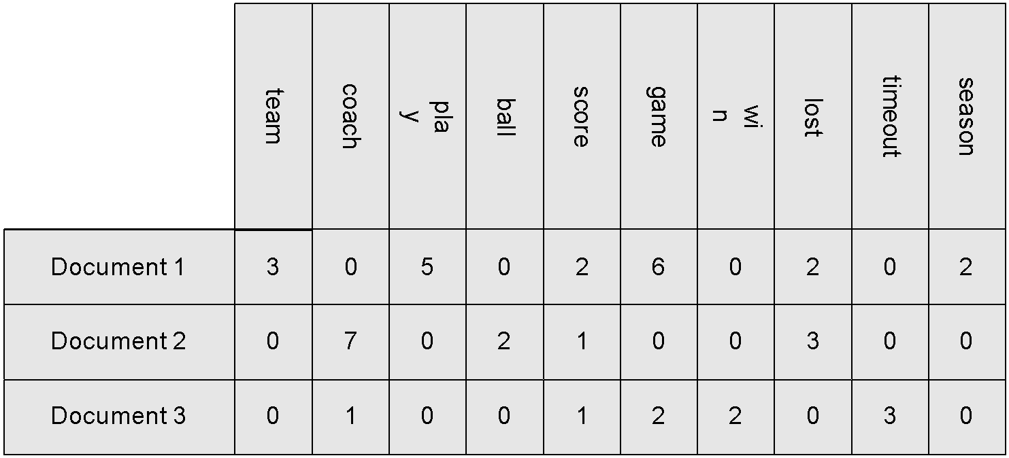
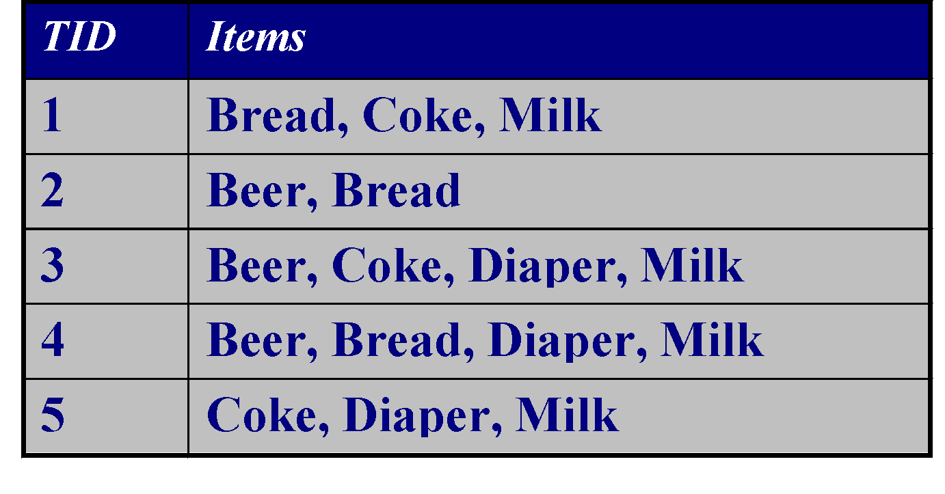
Types of Data Sets
Record
Relational records
Data matrix, e.g., numerical matrix, crosstabs
Document data: text documents: term-frequency vector
Transaction data
Graph and network
World Wide Web
Social or information networks
Molecular Structures
Ordered
Video data: sequence of images
Temporal data: time-series
Sequential Data: transaction sequences
Genetic sequence data
Spatial, image and multimedia:
Spatial data: maps
Image data
Video data

Slide 17
Data Objects
Data sets are made up of data objects.
A data object represents an entity.
Examples:
sales database: customers, store items, sales
medical database: patients, treatments
university database: students, professors, courses
Also called samples , examples, instances, data points, objects, tuples.
Data objects are described by attributes.
Database rows -> data objects; columns ->attributes.

Slide 18
Attributes
Attribute (or dimensions, features, variables): a data field, representing a characteristic or feature of a data object.
E.g., customer _ID, name, address
Types:
Nominal
Binary
Ordinal
Numeric: quantitative
Interval-scaled
Ratio-scaled

Slide 19
Attribute Types
Nominal: categories, states, or “names of things”
Hair_color = {auburn, black, blond, brown, grey, red, white}
marital status, occupation, ID numbers, zip codes
Binary
Nominal attribute with only 2 states (0 and 1)
Symmetric binary: both outcomes equally important
e.g., gender
Asymmetric binary: outcomes not equally important.
e.g., medical test (positive vs. negative)
Convention: assign 1 to most important outcome (e.g., HIV positive)
Ordinal
Values have a meaningful order (ranking) but magnitude between successive values is not known.
Size = {small, medium, large}, grades, army rankings

Slide 20
Numeric Attribute Types
Quantity (integer or real-valued)
Interval
Measured on a scale of equal-sized units
Values have order
E.g., temperature in C˚or F˚, calendar dates
No true zero-point
Ratio
Inherent zero-point
We can speak of values as being an order of magnitude larger than the unit of measurement (10 K˚ is twice as high as 5 K˚).
e.g., temperature in Kelvin, length, counts, monetary quantities

